Slide 1
COMP9024: Data Structures and Algorithms
Week 1: Abstract Data Types and Pointers

Slide 2
Contents
Abstract Data Types
Compilation and Makefiles
Pointers

Slide 3
Abstract Data Types (1/4)
A data type is a set of values, and a set of operations on those values
An ADT (Abstract Data Type) is a mathematical model for data types
An approach to implementing data types
Separates interface from implementation
Users of an ADT see only the interface
Builders of the ADT provide an implementation

Slide 4
Abstract Data Types (2/4)
An ADT interface provides
a user-view of the data structure
function signatures (prototypes) for all operations
semantics of operations (via documentation)
⇒ a "contract" between ADT and its clients
An ADT implementation gives
the concrete definition of the data structure
function implementations for all operations

Slide 5
Abstract Data Types (3/4)
ADT interfaces are opaque
Clients cannot see the implementation via the interface
ADTs are important because …
facilitate decomposition of complex programs
make implementation changes invisible to clients
improve readability and structuring

Slide 6
Abstract Data Types (4/4)
Typical operations with ADTs
create a value of the type
modify one variable of the type
combine two values of the type

Slide 7
Collection ADTs (1/4)
A collection consist of a group of items where each item may be a simple type or an ADT.
Items are typically of the same type and often have a key (to identify them)
Collections may be categorised by …
structure:
linear (array, linked list), branching (tree), cyclic (graph)
usage:
matrix, stack, queue, set, search-tree, dictionary, map, …

Slide 8
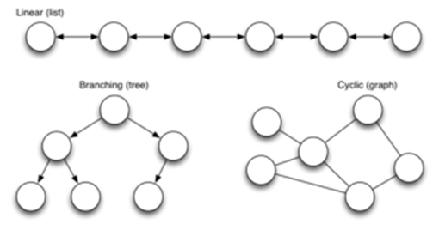
Collections (2/4)
Collection structures:

Slide 9
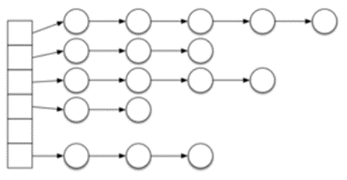
Collections (3/4)
Or even a hybrid structure like:

Slide 10
Collection (4/4)
For a given collection type
many different data representations are possible
For a given operation and data representation
several different algorithms are possible
efficiency of algorithms may vary widely
Generally,
there is no overall "best" representation/implementation
cost depends on the mix of operations
(e.g. proportion of inserts, searches, deletions, …)

Slide 11
Stack ADT (1/2)
A stack is an abstract data type that serves as a collection of elements, with the following operations:
createStack(), which creates an empty stack.
push(element), which adds an element to the collection, and
pop(), which removes the top element from the stack.
peek(), which returns the top element without modifying the stack.
isEmpty(), which checks if the stack is empty.
Elements come off a stack following LIFO ( Last In First Out) order.

Slide 12
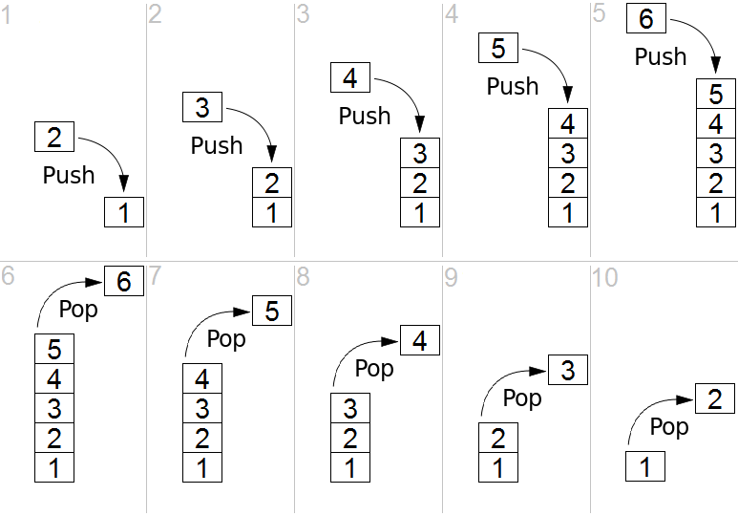
Stack ADT (2/2)
https://en.wikipedia.org/wiki/Stack_(abstract_data_type)

Slide 13
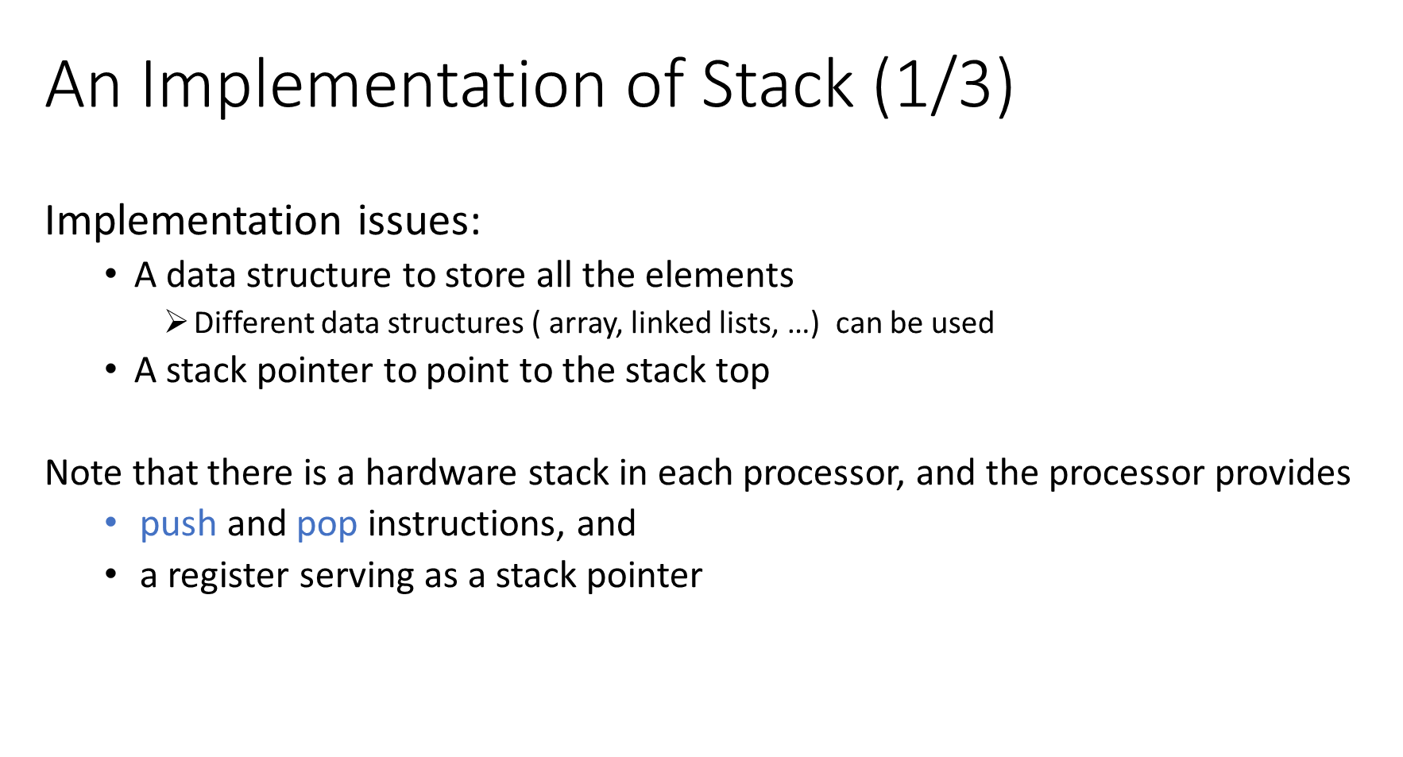

Slide 14
An Implementation of Stack (2/3)
Interface (a file named Stack.h)
// Stack header file
void stackInit();
int isEmpty();
void push(char);
char pop();

Slide 15
An Implementation of Stack (3/3)
#include "Stack.h"
#define MAXITEMS 10
static struct {
char item[MAXITEMS];
int top;
} stackObject;
void push(char ch) {
assert(stackObject.top < MAXITEMS-1);
stackObject.top++;
int i = stackObject.top;
stackObject.item[i] = ch;
}
char pop() {
assert(stackObject.top > -1);
int i = stackObject.top;
char ch = stackObject.item[i];
stackObject.top--;
return ch;
}
void stackInit() {
stackObject.top = -1;
}
int isEmpty() {
return (stackObject.top < 0);
}

Slide 16
Applications of Stacks
Direct applications
Page-visited history in a Web browser
Undo sequence in a text editor
Chain of method calls in the Java Virtual Machine
Indirect applications
Auxiliary data structure for algorithms
Component of other data structures

Slide 17
Bracket Matching (1/5)
Check whether all opening brackets such as '(', '[', '{' have matching closing brackets ')', ']', '}'
Which of the following expressions are correct?
1. (a+b) * c
2. a[i]+b[j]*c[k])
3. (a[i]+b[j])*c[k]
4. a(a+b]*c
5. void f(char a[], int n) {int i; for(i=0;i<n;i++) { a[i] = (a[i]*a[i])*(i+1); }}
6. a(a+b * c
________________________________________
1. Correct
2. Not correct (case 1: an opening bracket is missing)
3. Correct
4. Not correct (case 2: closing bracket doesn't match opening bracket)
5. Correct
6. Not correct (case 3: missing closing bracket)

Slide 18
Bracket Matching (2/5)
Algorithm
| return TRUE

Slide 19
Bracket Matching (3/5)

Slide 20
Bracket Matching (4/5)

Slide 21
Bracket Matching (5/5)

Slide 22
Queue ADT (1/4)
A queue consists of a linear sequence of an arbitrary number of items with the following major operations:
enqueue(element): add a new element at the end of the queue
dequeue(): remove the element at the front of the queue
Other auxiliary operations:
front(): returns the element at the front without removing it
size(): returns the number of elements stored
isEmpty(): indicates whether no elements are stored
All the elements are removed from the queue following FIFO (First In First Out) order.

Slide 23
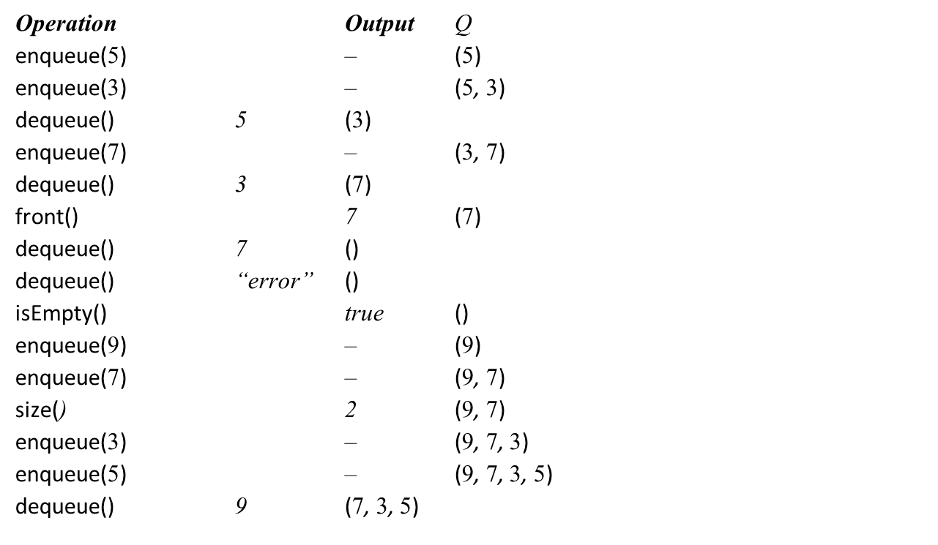
Queue ADT (2/4)

Slide 24
Queue ADT (3/4)
Applications of queues
Direct applications
Waiting lists, bureaucracy
Access to shared resources (e.g., printer)
Multiprogramming
Indirect applications
Auxiliary data structure for algorithms
Component of other data structures

Slide 25
Queue ADT (4/4)
A queue can be implemented using an array or a linked list
Two variables keep track of the front and rear

Slide 26
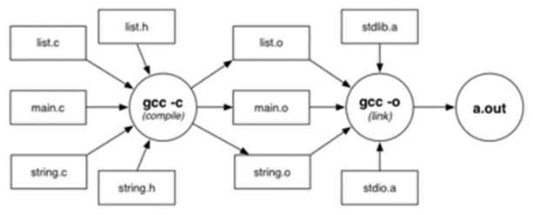
Compilation and Makefiles (1/7)

Slide 27
Compilation and Makefiles (2/7)
Compilation/linking with gcc:
gcc -c Stack.c
gcc -c bracket.c
gcc -o rbt bracket.o Stack.o
gcc is a multi-purpose tool
• compiles (-c), links, makes executables (-o)

Slide 28
Compilation and Makefiles (3/7)
Compilation process is complex for large systems.
How much to compile?
• Ideally, what's changed since last compile
• Practically, recompile everything, to be sure
The make command assists by allowing
• programmers to document dependencies in code
• minimal re-compilation, based on dependencies

Slide 29
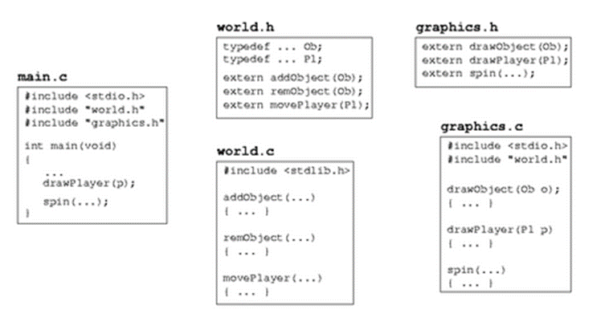
Compilation and Makefiles (4/7)
Example: multi-module program

Slide 30
Compilation and Makefiles (5/7)
make is driven by dependencies given in a Makefile
A dependency specifies
target : source1 source2 …
commands to build target from sources
e.g.
game : main.o graphics.o world.o
gcc -o game main.o graphics.o world.o
Rule: target is rebuilt if older than any source

Slide 31
Compilation and Makefiles (6/7)
A Makefile for the example program:
game : main.o graphics.o world.o
gcc -o game main.o graphics.o world.o
main.o : main.c graphics.h world.h
gcc -Wall -Werror -c main.c
graphics.o : graphics.c world.h
gcc -Wall -Werror -c graphics.c
world.o : world.c
gcc -Wall -Werror -c world.c
Things to note:
• A target (game, main.o, …) is on a newline
followed by a :
then followed by the files that the target is dependent on
• The action (gcc …) is always on a newline
and must be indented with a TAB

Slide 32
Compilation and Makefiles (7/7)
If make arguments are targets, build just those targets:
prompt$ make world.o
gcc -Wall -Werror -c world.c
If no args, build first target in the Makefile.
prompt$ make
gcc -Wall -Werror -c main.c
gcc -Wall -Werror -c graphics.c
gcc -Wall -Werror -c world.c
gcc -o game main.o graphics.o world.o

Slide 33
Memory (1/3)
Computer memory … large array of consecutive data cells or bytes
• char … 1 byte int, float … 4 bytes double … 8 bytes
When a variable is declared, the operating system finds a place in memory to store the appropriate number of bytes.
If we declare a variable called k …
• the place where k is stored is denoted by &k
• also called the address of k
It is convenient to print memory addresses in Hexadecimal notation
Memory
Byte 0
Byte 1
Byte 2
Byte i

Slide 34
Memory (2/3)
Example:
int k;
int m;
printf("address of k is %p\n", &k);
printf("address of m is %p\n", &m);
// address of k is BFFFFB80
// address of m is BFFFFB84
This means that
• k occupies the four bytes from BFFFFB80 to BFFFFB83
• m occupies the four bytes from BFFFFB84 to BFFFFB87
Note the use of %p as placeholder for an address ("pointer" value)

Slide 35
Memory (3/3)
When an array is declared, the elements of the array are stored in consecutive memory locations:
int array[5];
for (i = 0; i < 5; i++) {
printf("address of array[%d] is %p\n", i, &array[i]);
}
// address of array[0] is BFFFFB60
// address of array[1] is BFFFFB64
// address of array[2] is BFFFFB68
// address of array[3] is BFFFFB6C
// address of array[4] is BFFFFB70

Slide 36
Pointers (1/4)

Slide 37
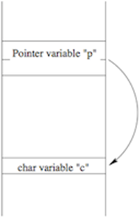
Pointers (2/4)

Slide 38
Pointers (3/4)

Slide 39
Pointers (4/4)

Slide 40
Examples of Pointers (1/5)
int *p; int *q;
int a[5];
int x = 10, y;
p = &x;
*p = 20;
y = *p;
p = &a[2];
q = p;

Slide 41
Examples of Pointers (2/5)

Slide 42
Examples of Pointers (3/5)

Slide 43
Examples of Pointers (4/5)
Recall that in C, scalar parameters are passed "by-value"
Changes made to the value of a parameter do not affect the original
Function swap() tries to swap the values of a and b, but fails because it only swaps the copies, not the "real" variables in main()
We can achieve "simulated call-by-reference" by passing pointers as parameters

Slide 44
Examples of Pointers (5/5)

Slide 45
Pointers and Arrays (1/3)

Slide 46
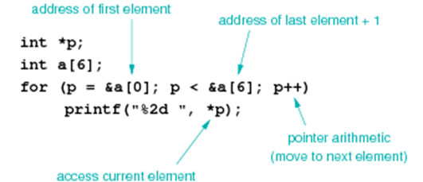
Pointers and Arrays (2/3)
Pointer-based scan written in more typical style
Note: because of pointer/array connection a[i] == *(a+i)

Slide 47
Pointers and Arrays (3/3)
argv can also be viewed as double pointer (a pointer to a pointer)
Alternative prototype for main():
int main(int argc, char **argv)
{
...
}
Can still use argv[0], argv[1], …

Slide 48
Pointer Arithmetic (1/7)
A pointer variable holds a value which is an address.
C knows what type of object is being pointed to
• It knows the sizeof that object
• It can compute where the next/previous object is located
Example:
int a[6];
int *p;
p = &a[0];
p = p + 1;

Slide 49
Pointer Arithmetic (2/7)

Slide 50
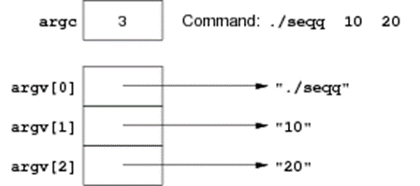
Pointer Arithmetic (3/7)
One common type of pointer/array combination are the command line arguments
• These are 0 or more strings specified when a program is run
• If you run this command in a terminal:
prompt$ ./seqq 10 20
then seqq will be given 2 command-line arguments: "10", "20"
Each element of argv[] is
• a pointer to the start of a character array (char *)
containing a \0-terminated string

Slide 51
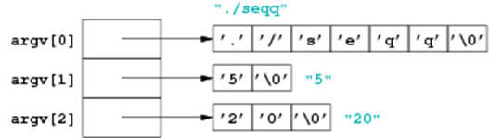
Pointer Arithmetic (4/7)
More detail on how argv is represented:
prompt$ ./seqq 5 20

Slide 52
Pointer Arithmetic (5/7)

Slide 53
Pointer Arithmetic (6/7)
Write a program that
• checks for a single command line argument
if not, outputs a usage message and exits with failure
• converts this argument to a number and checks that it is positive
• applies the following Collatz's process, until 1 is reached:
If n is even, set n to n/2
If n is odd, set n to 3*n+1

Slide 54
Pointer Arithmetic (7/7)

Slide 55
Pointers and Structures (1/3)
Like any object, we can get the address of a struct via &.
typedef char Date[11];
typedef struct {
char name[60];
Date birthday;
int status;
float salary;
} WorkerT;
WorkerT w; WorkerT *wp;
wp = &w;
*wp.salary = 125000.00;
w.salary = 125000.00;
*(wp.salary) = 125000.00;
(*wp).salary = 125000.00;
// wp->salary = 125000.00;

Slide 56
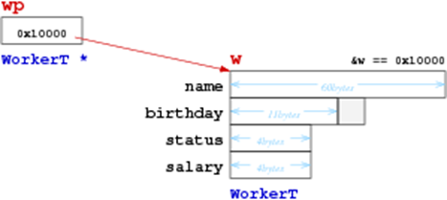
Pointers and Structures (2/3)
Diagram of scenario from program above:

Slide 57
Pointers and Structures (3/3)
General principle …
If we have:
SomeStructType s, *sp = &s;
then the following are all equivalent:
s.SomeElem sp->SomeElem (*sp).SomeElem

Slide 58
Summary
• Introduction to ADTs
• Compilation and Makefiles
• Pointers
• Suggested reading:
introduction to ADTs … Sedgewick, Ch.4.1-4.3
pointers … Moffat, Ch.6.6-6.7

